Slide 1
Chapter 19. The First Law of Thermodynamics
The First Law: Internal Energy
∆U = Q – W, or differentially,
dU = dQ-dW,
where Q = mc ∆T = heat added to system (+ive), and W is work done by the system on the environment(+ive). W =∫pdV.

Slide 2
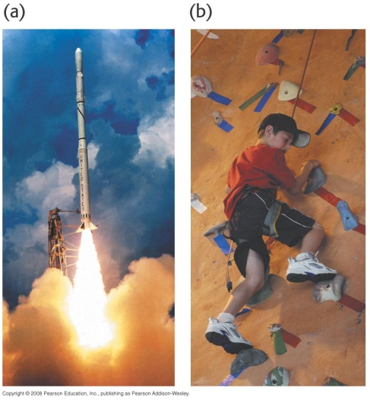
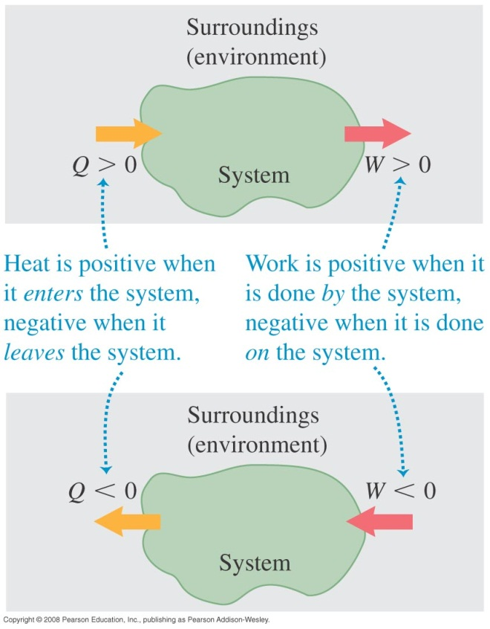
Symbols, signs, and definitions for heat and work
A system is contained in 3-D space region and everything else is the surroundings.
Diagrams to right give signs for work done by or on system and surroundings.
Note the signs for heat added or removed from system or surroundings.

Slide 3
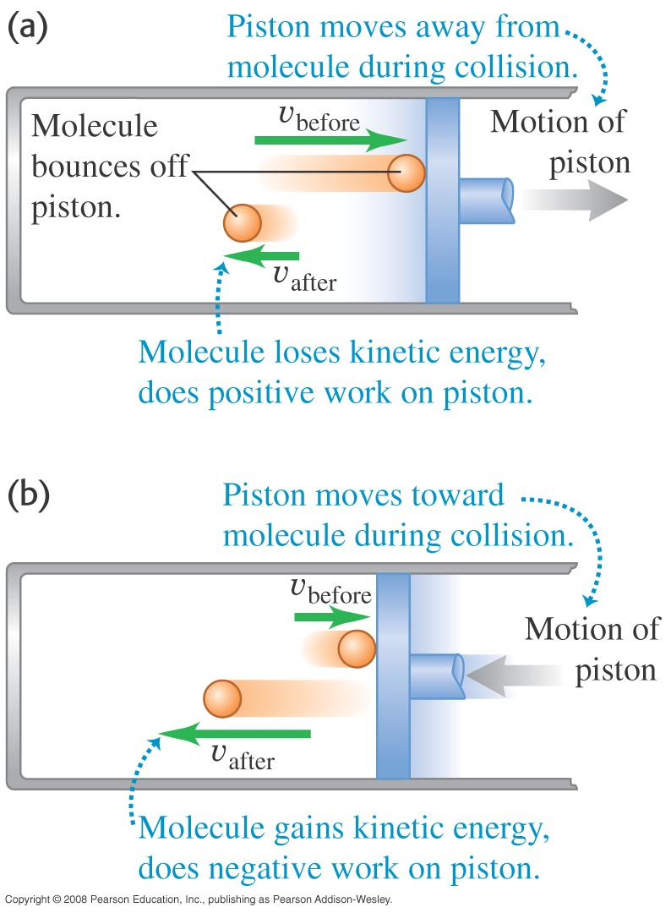
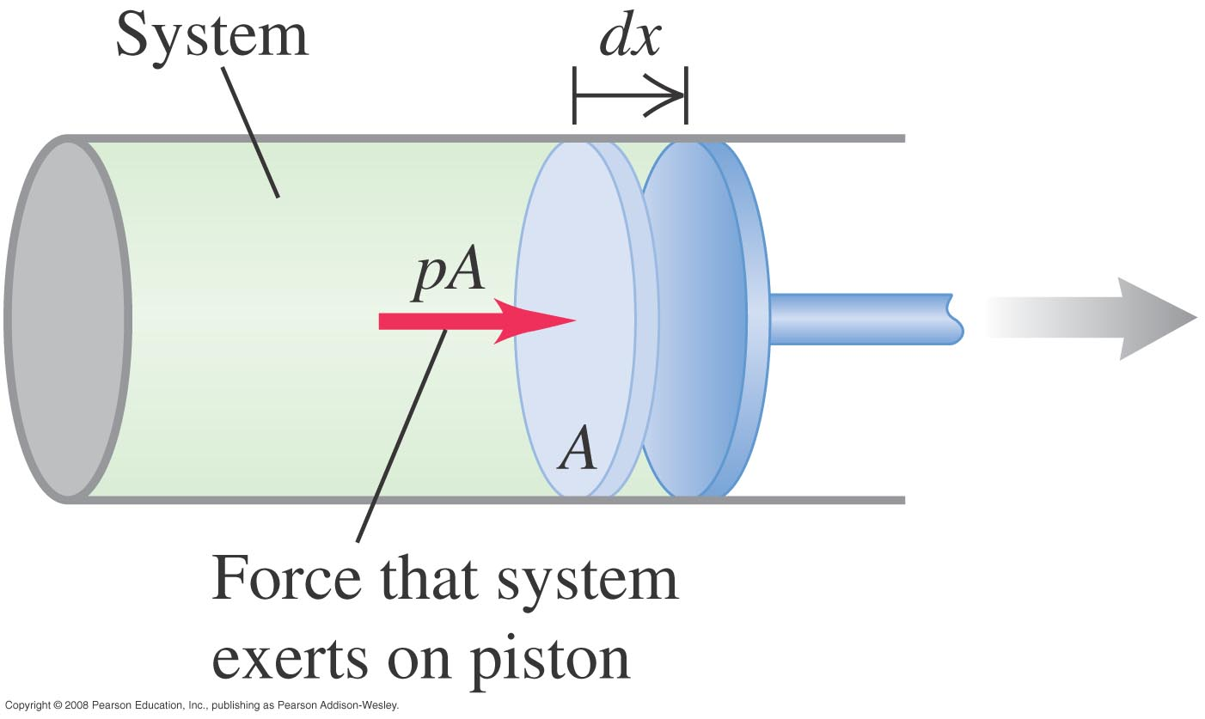
Work as the change of pressure and volume
Let’s expand the idea of work being a force times a distance. Pressure, p = F/A = force/(Area applied). Thus work dW = Fdx = pAdx = pdV (V= Volume).

Slide 4
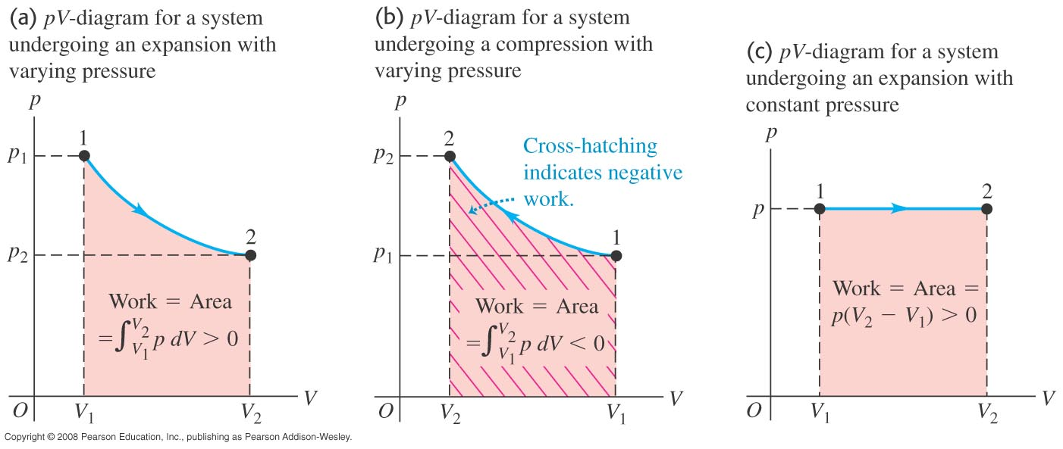
Work is determined by integration
Work in a PV change is determined by integrating the area under the curve describing the change.

Slide 5
Does the path of the PV change matter?
The start, the finish, and the shape of the curve are all significant.

Slide 6
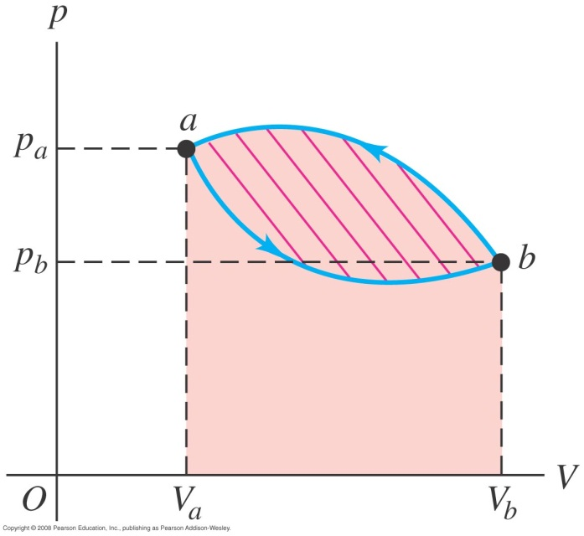
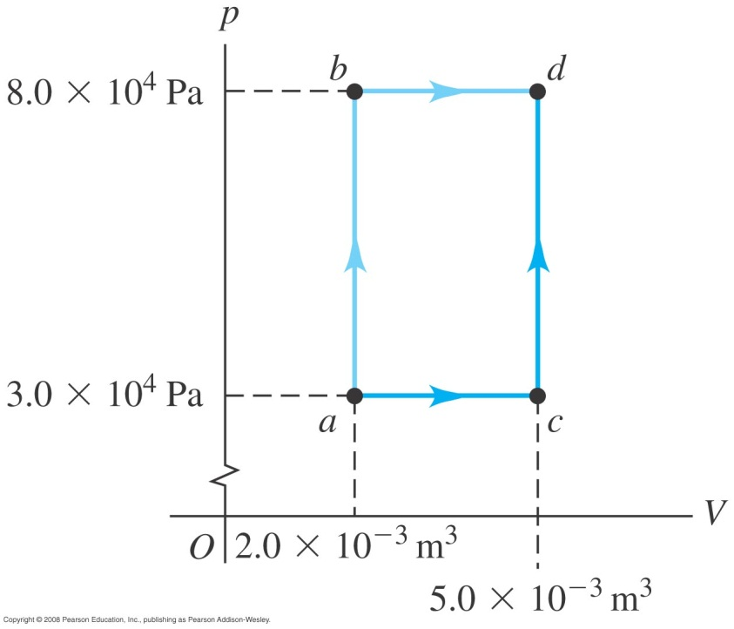
Study of thermodynamic processes
Different paths in p, V plane—different work.
Two cyclic processes pictured.

Slide 7
Simple processes:
Isobaric = constant pressure → W = p ∆V
Adiabatic = no heat exchange, Q → ∆U= - W Ex. Free (adiabatic) rapid expansion.
γ = C_{p}/C_{v}, TV^{γ-1} = constant,
pV^{γ} = constant.
Isochoric = constant volume → W = 0
Isothermal = constant temperature → if ideal gas, U is proportional to T (not p or V), ∆U = 0 and Q = W.
For an ideal gas, C_{p} (constant pressure) = C_{v} (constant volume) + R.

Slide 8
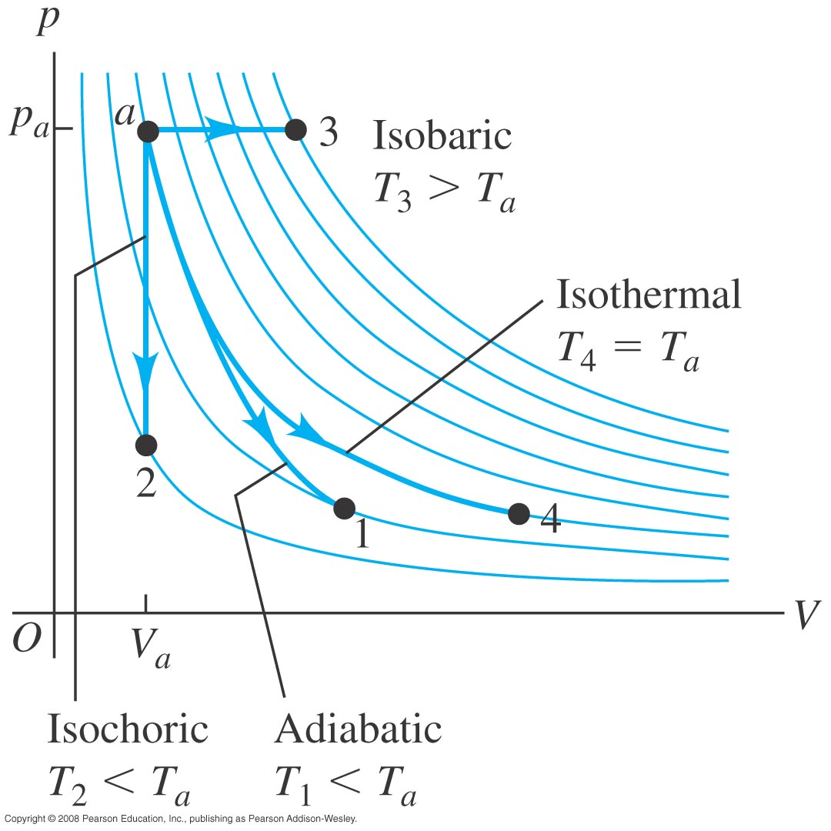
The processes on a PV diagram
Notice the subtle differences for each curve.

Slide 9
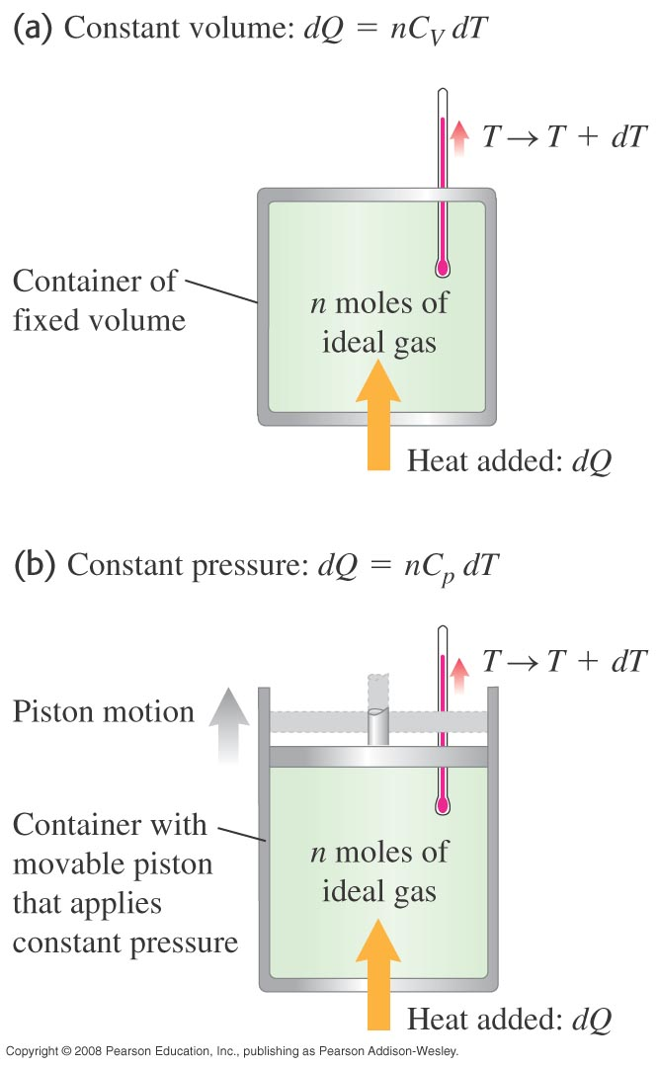
Measuring heat capacities
Heat capacities may be measured at constant volume in a fairly complex process using a bomb calorimeter.
Heat capacities may be measured at constant pressure using equipment as simple as a coffee cup.

Slide 10
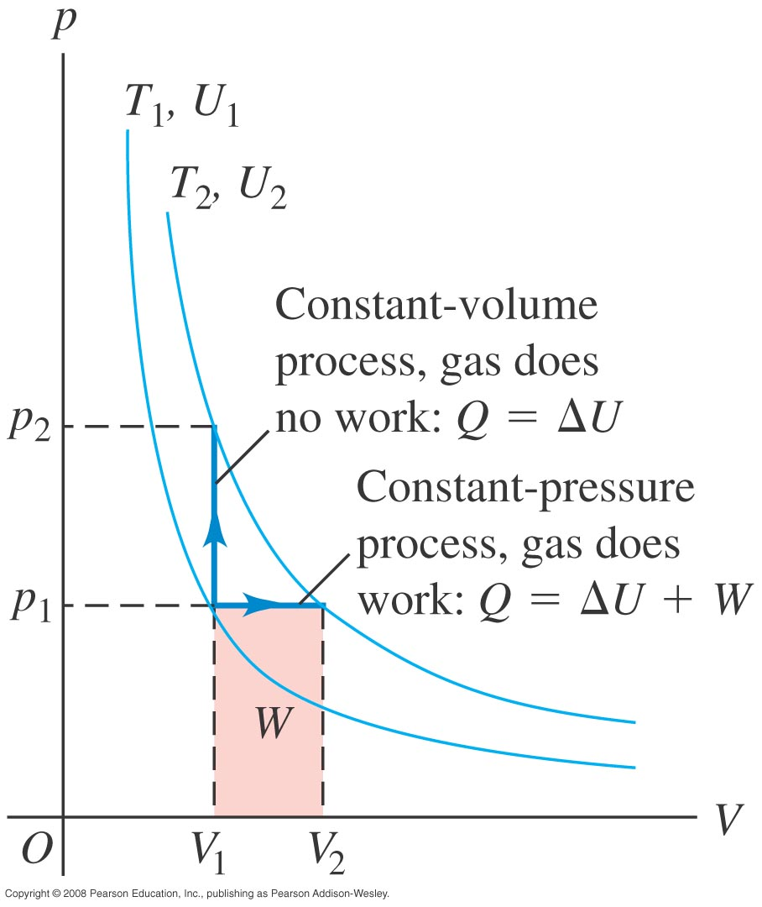
Relating heat capacities at constant volume and pressure

Slide 11
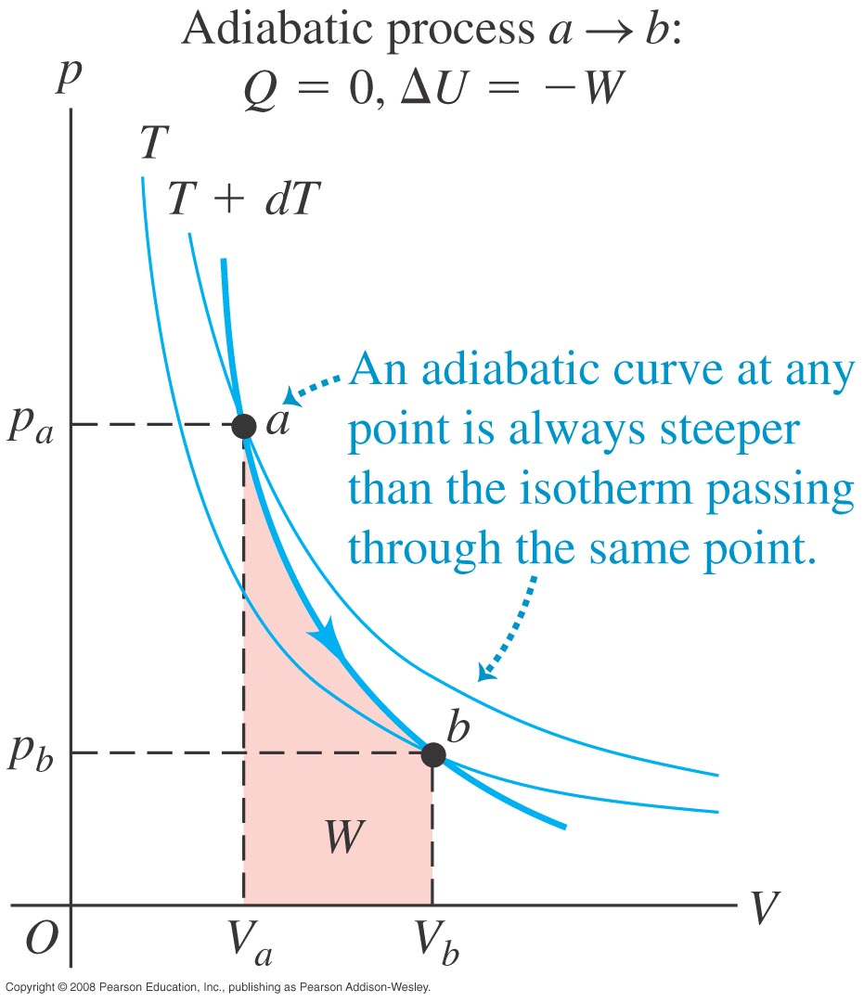
Adiabatic changes
In an adiabatic process, no heat is transferred from system and surroundings.

Slide 12
Chapter 20. The Second Law of Thermodynamics. (4 versions):
1. Heat flows spontaneously from hot to cold, not the other way around. Clausius.
2. Heat cannot be converted completely into work. The efficiency of a heat engine or refrigerator is never = 100%. Efficiency, e = W/Q_{H} = 1 – |Q_{C}/Q_{H}| and 2nd Law is that e never reaches 1.
3. Entropy (∆S = Q/T at a constant temperature) always increases for a macroscopic closed system). ∆S≥0. ∆S = ∫dQ/T. This is the same for all processes leading between two states. Thus we can choose a process which is easy to calculate (like isothermal, T =const.).
4. Information: S = k ln w, where w is the number of microscopic states.

Slide 13
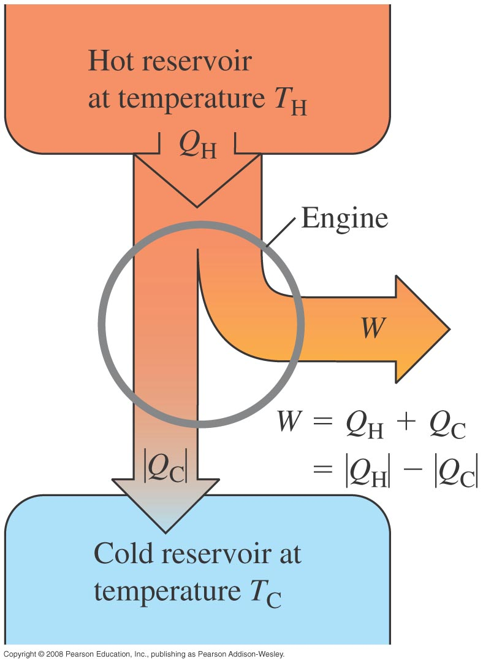
2nd Version: Energy flow diagrams: efficiency of heat engines.
As heat flows from a reservoir at higher temperature to a sink at lower temperature, work may be removed.
THERMAL EFFICIENCY:
e = W/QH = 1 - │QC/QH│ <--------
Related to 2nd Version of 2nd law:
Heat cannot be converted completely into work.

Slide 14
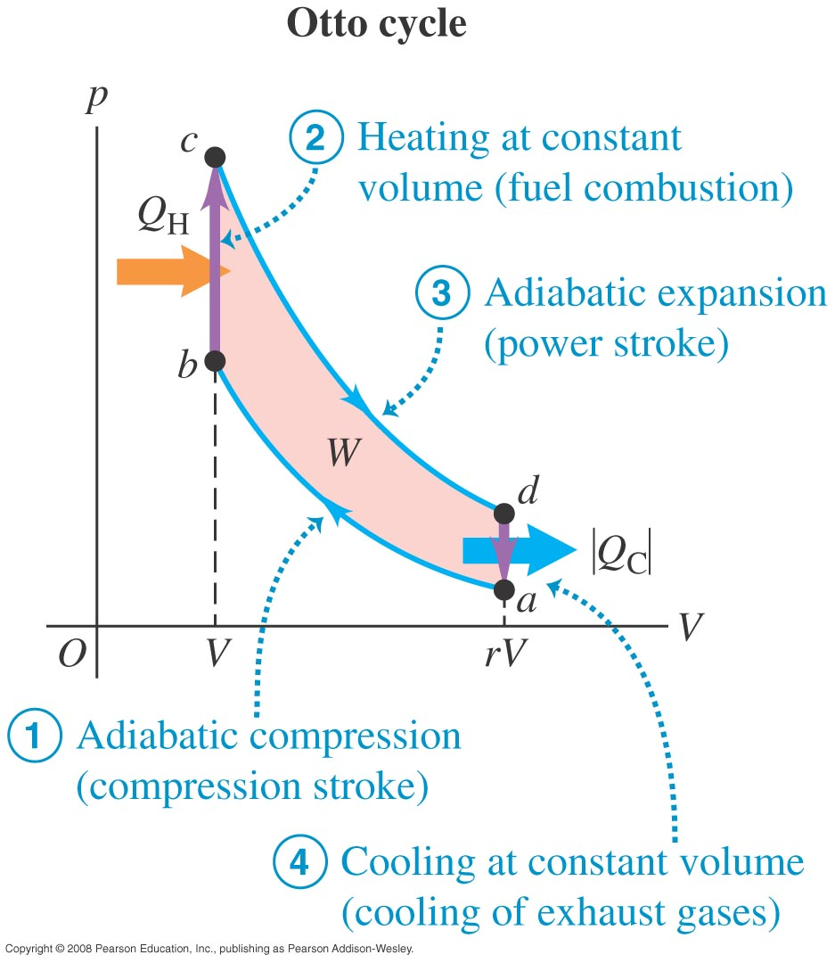
The Otto (normal auto) Cycle:
A fuel vapor can be compressed, then detonated to rebound the cylinder, doing useful work.
The four processes lead to
Otto Cycle Efficiency:
(derived in notes)
e = 1 – 1/r^{γ-1},
where γ = Cp/Cv
and r = compression ratio
(for normal autos r = about 8) .

Slide 15
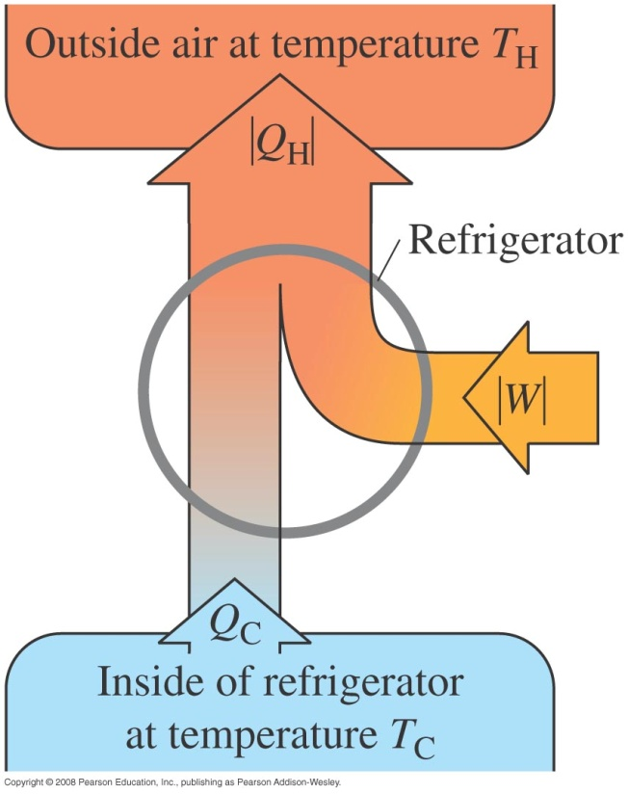
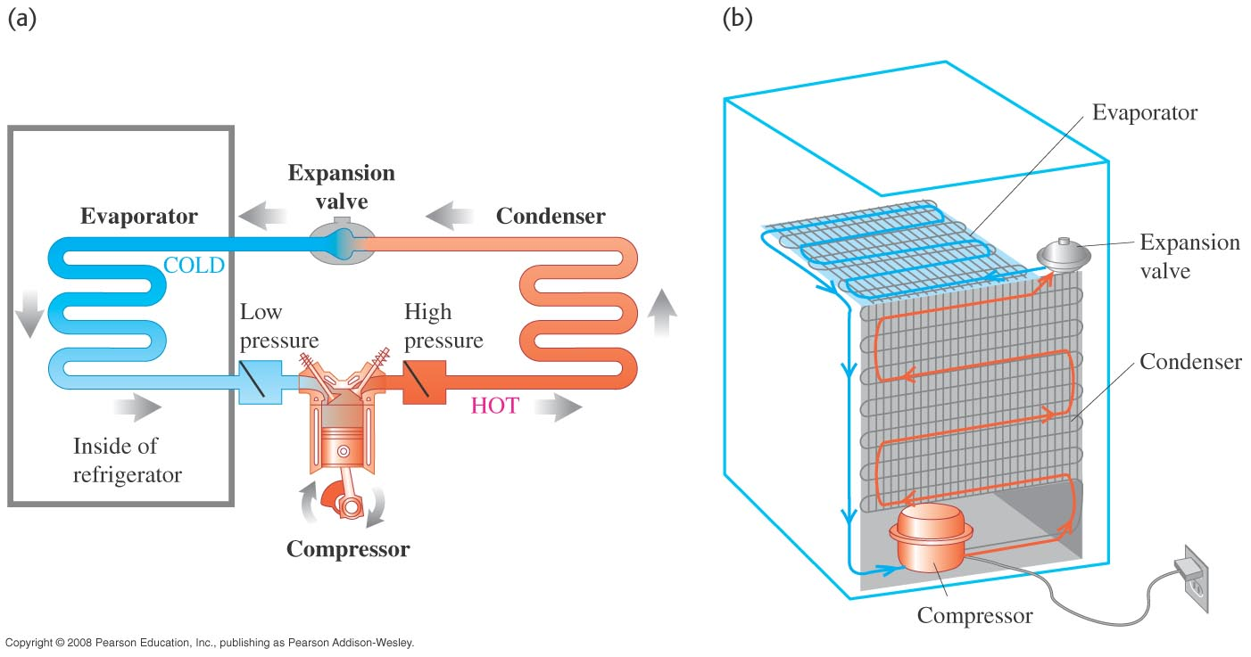
Refrigerators
Refrigerator: heat engine running backwards.
Performance Coefficient:
K =│Q_{C}│/(│Q_{H}│-│Q_{C}│)

Slide 16
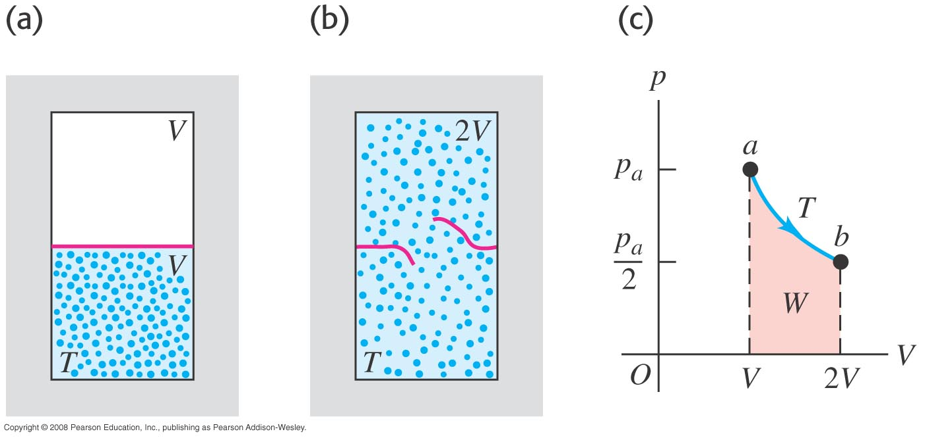
Entropy in gas expansion at constant temperature:
1st Law dQ = dW = pdV = (nRT/V)dV → dV/V = dQ/nRT
Thus increase in complexity (disorder) is proportional to
dQ/T = S ( definition of Entropy)

Slide 17
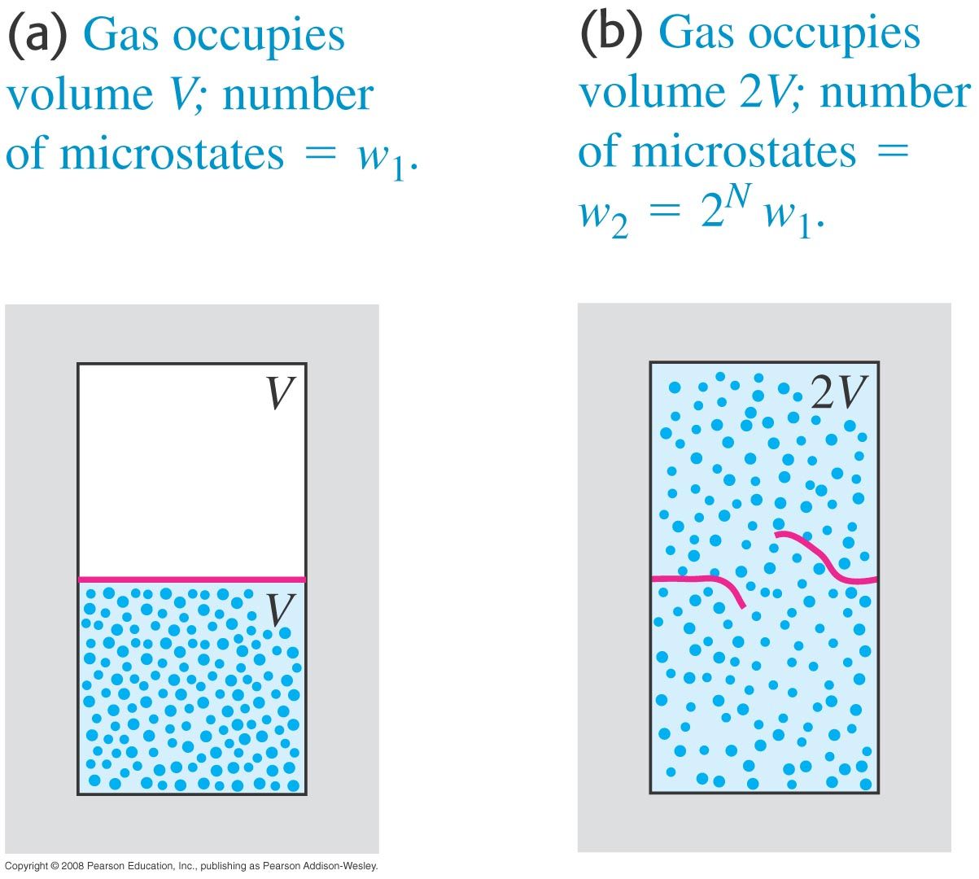
A gas in the microscopic, statistical model
Thus Entropy is related to information: ∆S = k ln (w₂/w₁) = nRln2

Slide 18
‘Law’ of Entropy is violated microscopically
Consider 6 atoms we trap in ½ the volume by watching the atoms. Entropy can thus decrease for a isolated microscopic system.
Thus the entropic arrow of time is not a good one I claim. The quantum arrow of time (narrowing possibilities) is more fundamental.

